Slide 1

Noise sealing
Dongsheng Yang
2023.7.20

Slide 2
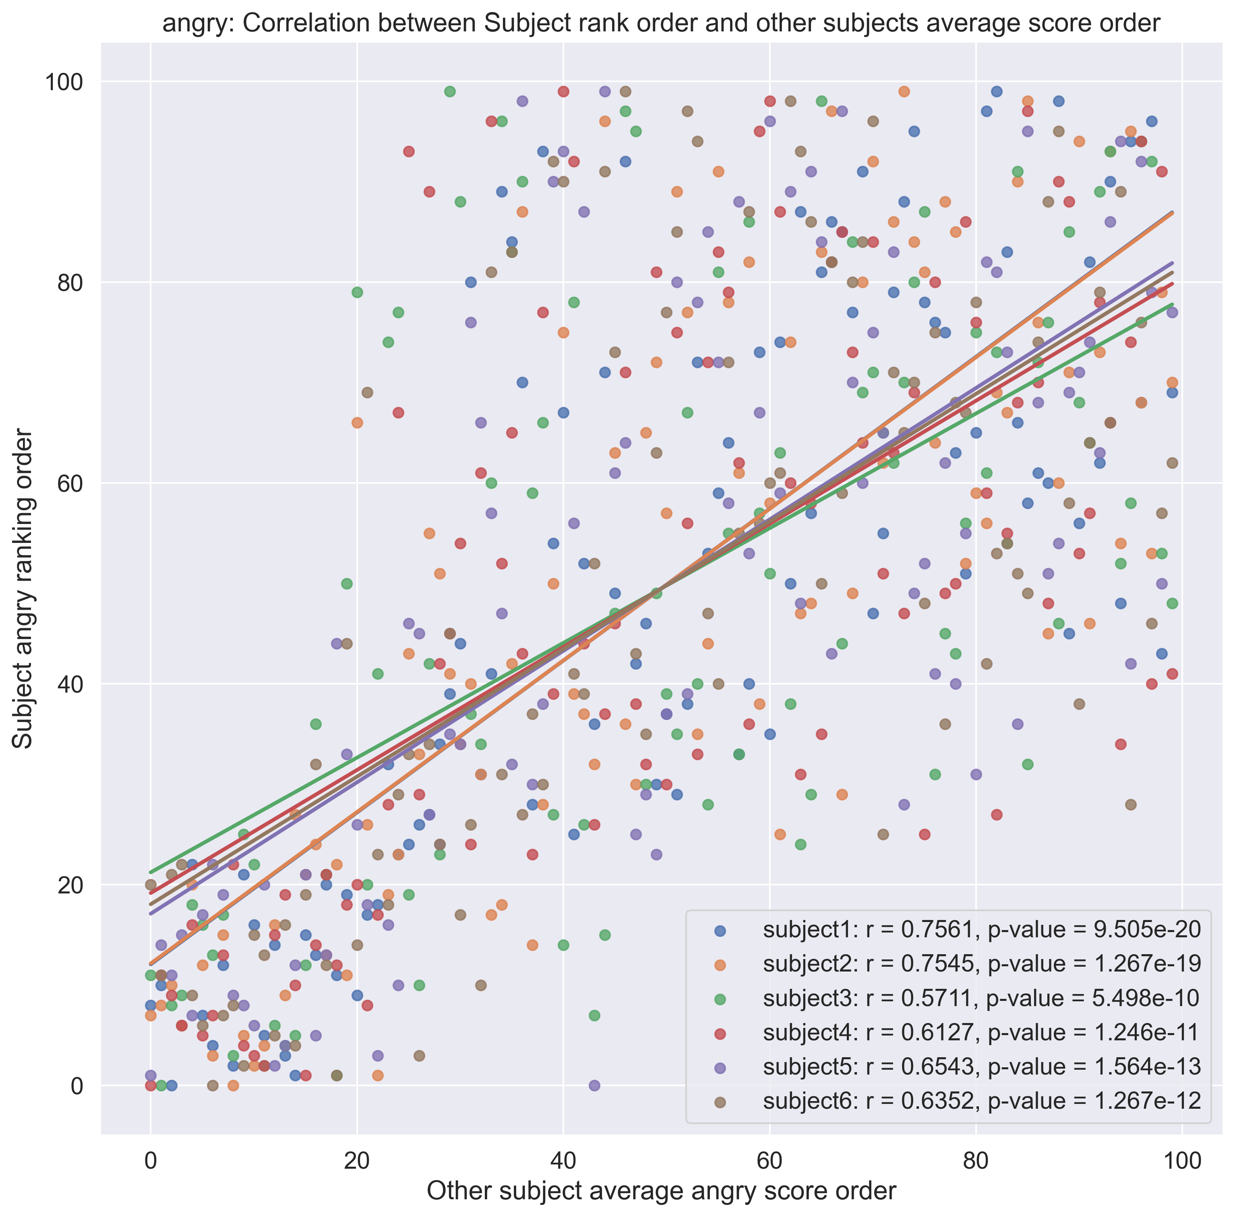
Anger

Slide 3
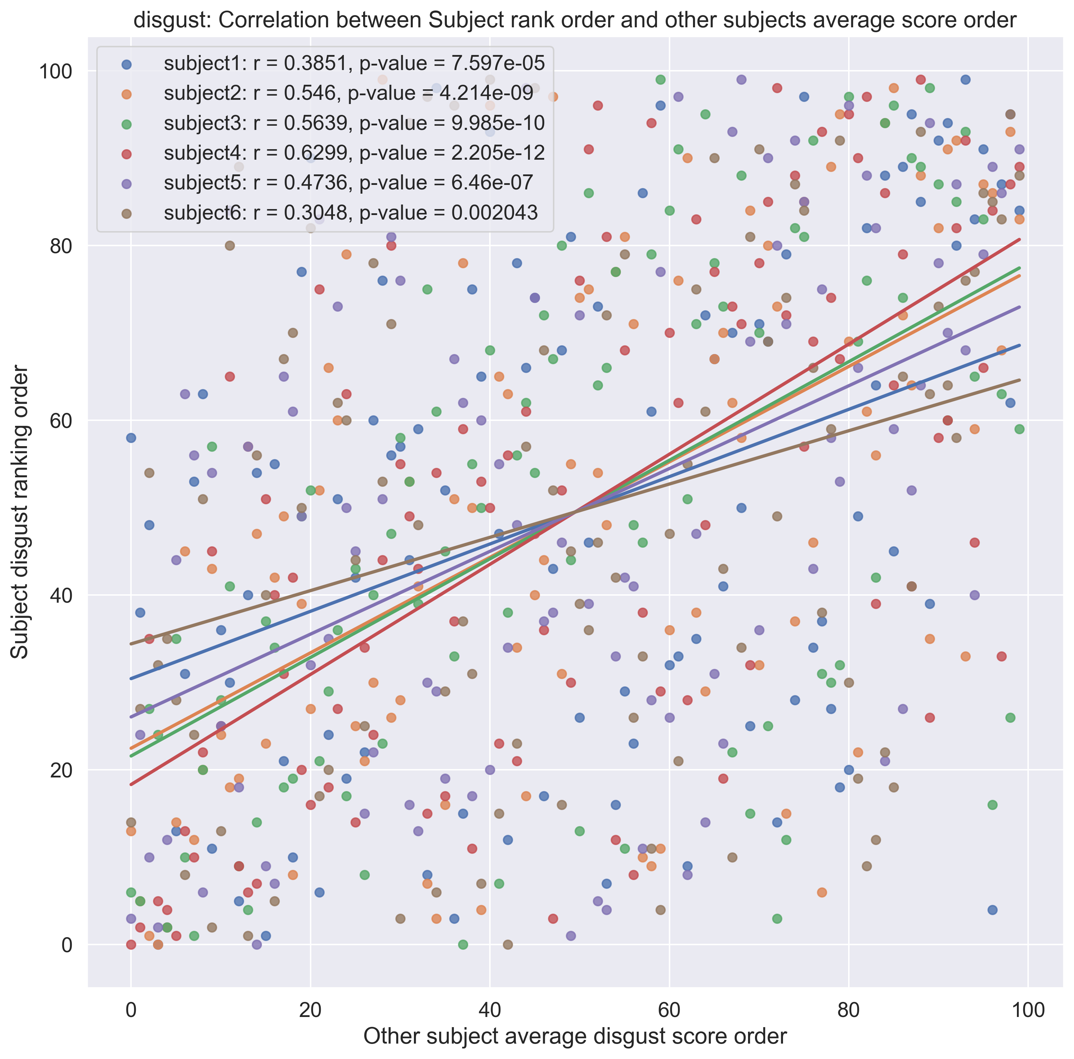
Disgust

Slide 4
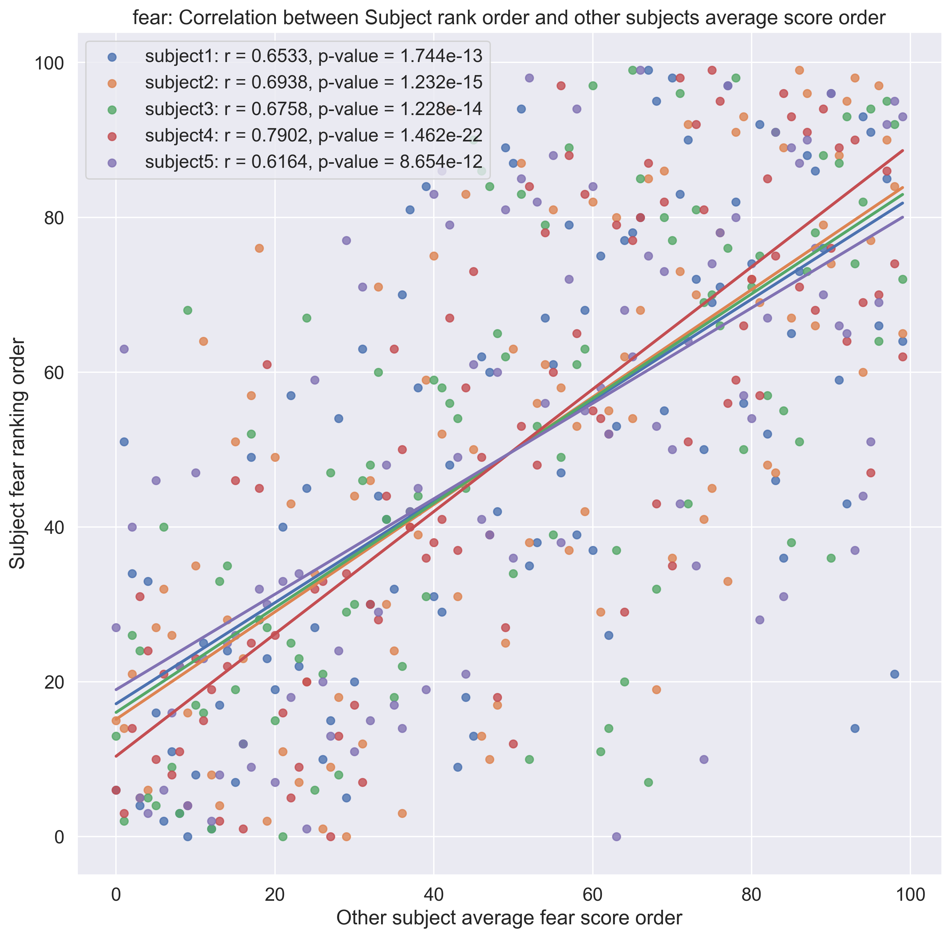
Fear

Slide 5
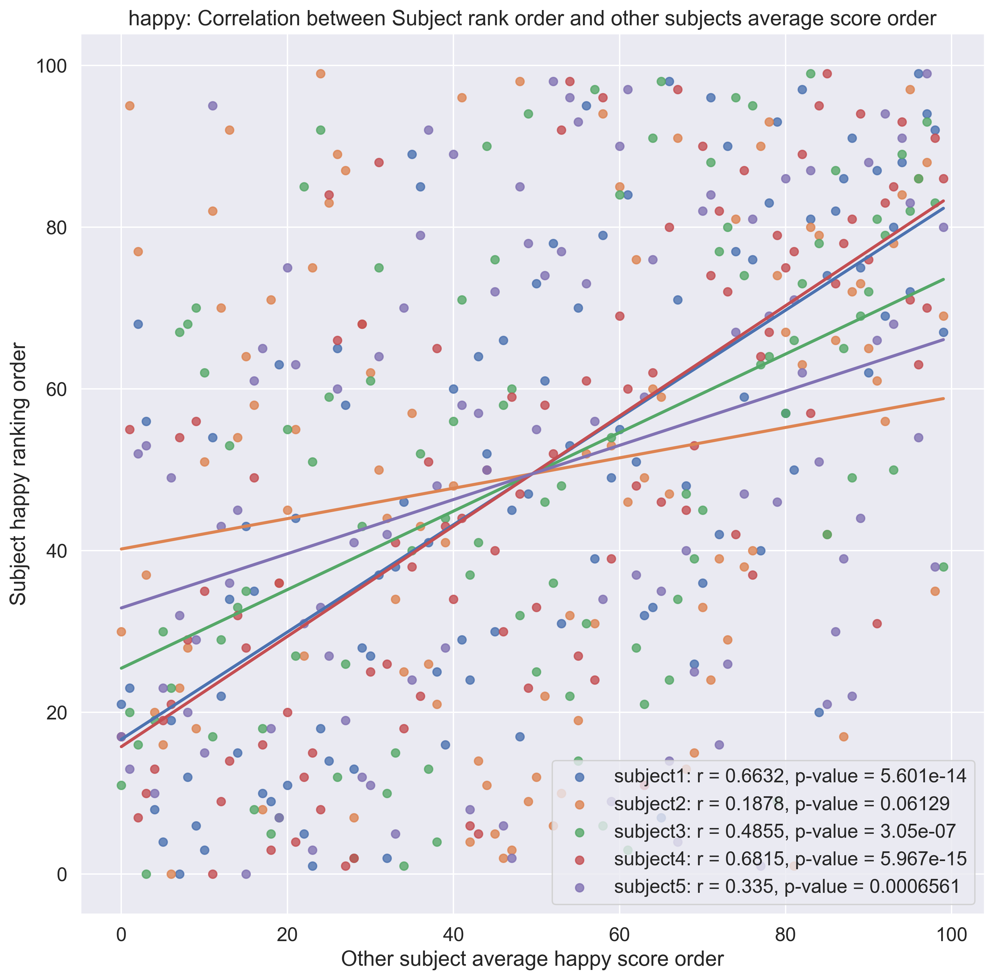
Happiness

Slide 6
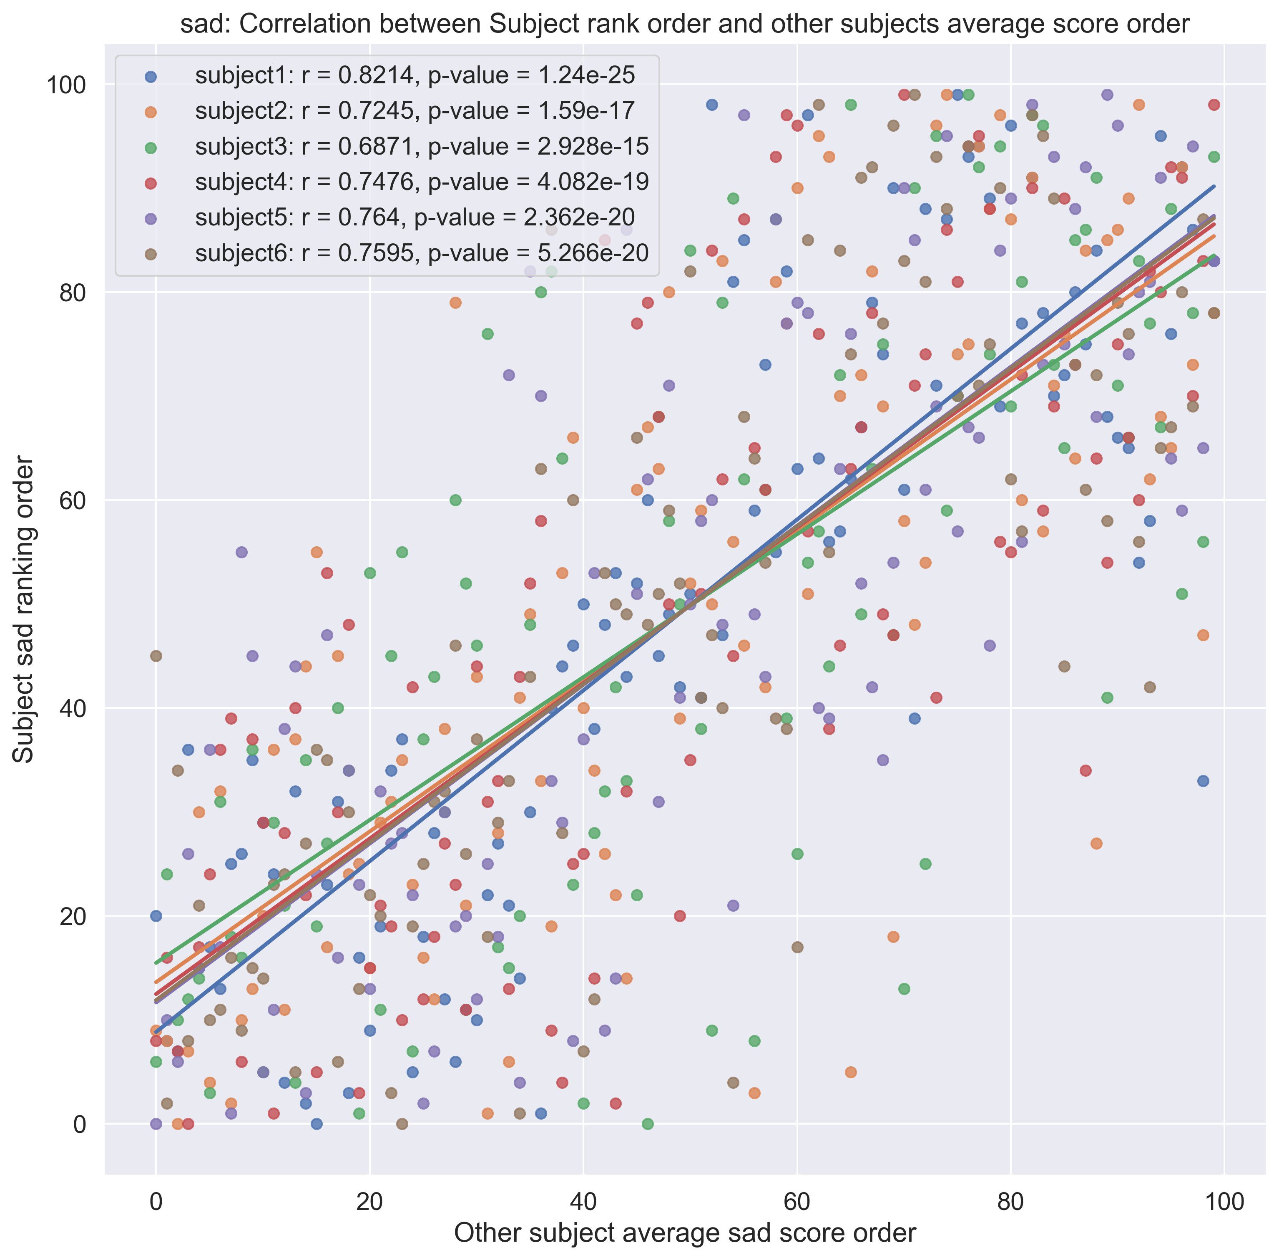
Sad

Slide 7
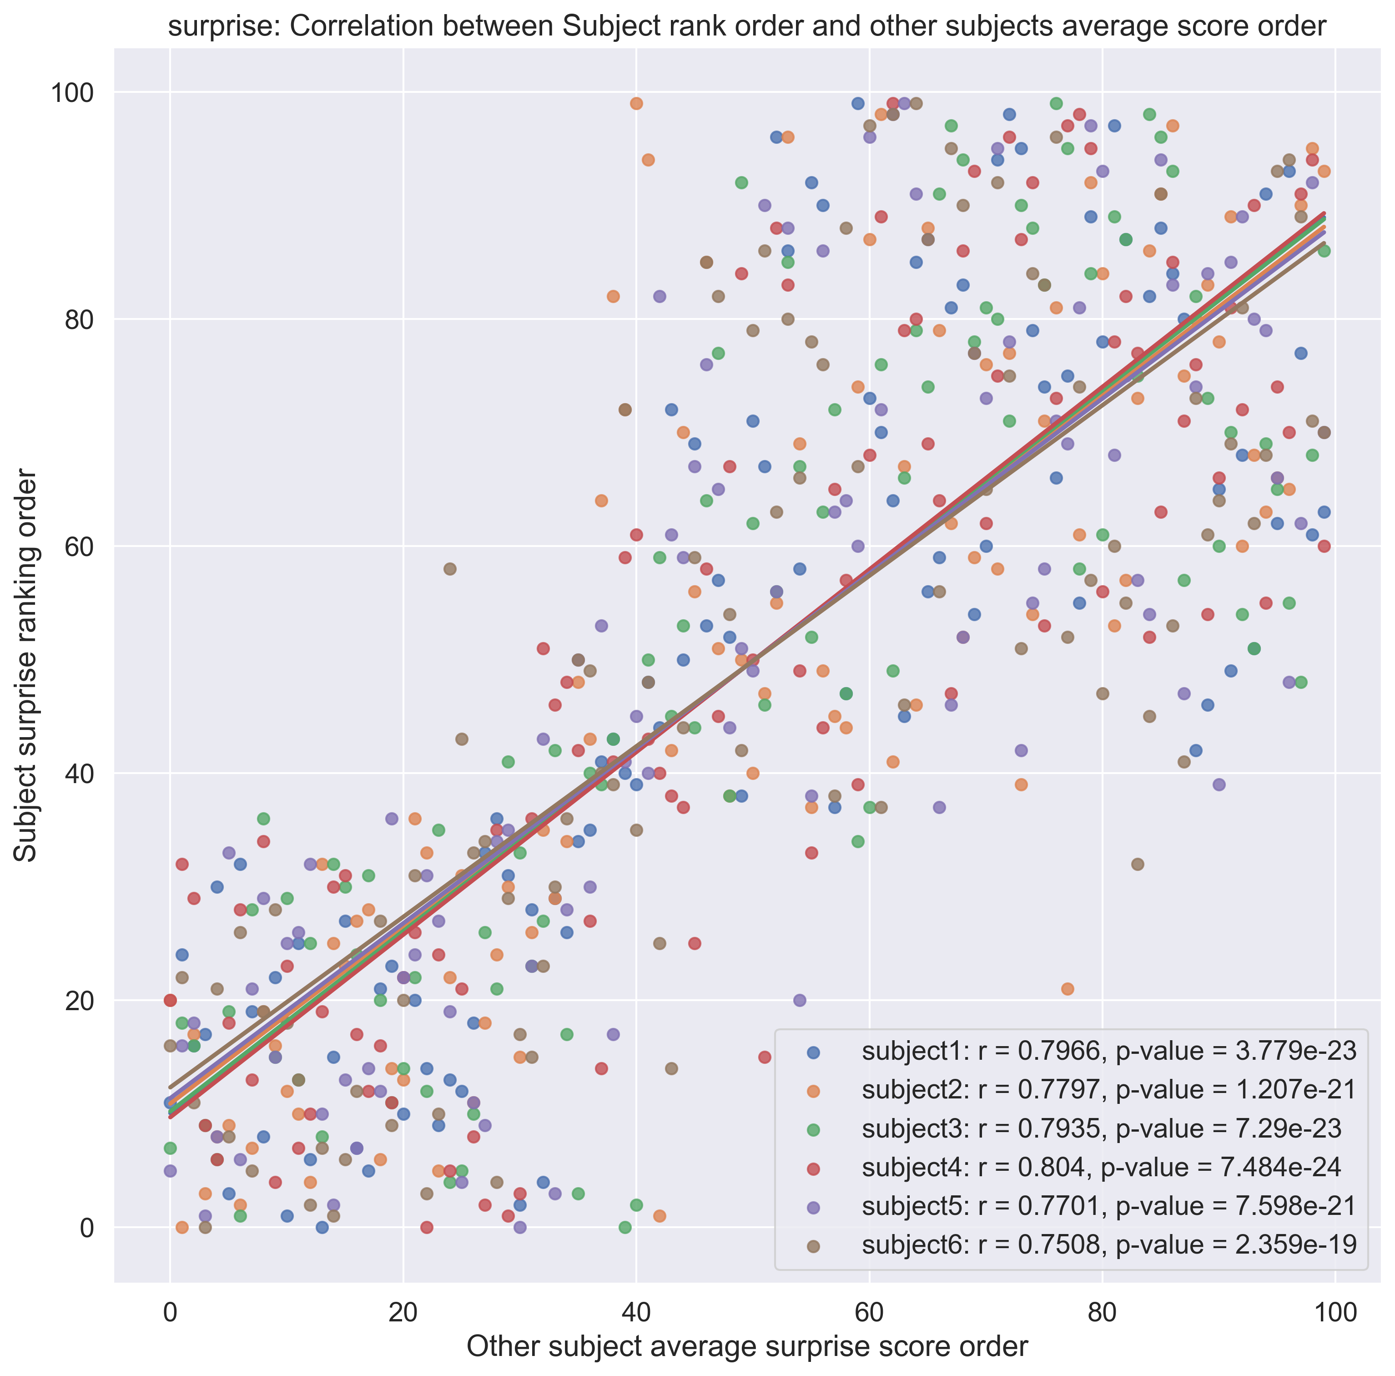
Surprise

